Slide 1
Financial Data in Healthcare
Caleb Class, PhD
RX 319

Slide 2
Learning Objectives
Explain the relevance of financial data in healthcare.
List types of financial data in healthcare.
List the four main types of financial statements.
Describe the contents of a balance sheet.
2

Slide 3
Yup, it’s a business
Someday, you might have to…
Analyze your inventory and budget to ensure adequate inventory and staffing
Decide whether to meet a competitor’s price
Negotiate purchases from pharmaceutical manufacturers
Decide whether to dispense a certain medication after your computer gives you a “red flag” that the reimbursement is below cost
Make a household budget
Herist, Rollins & Perri III. Financial Analysis in Pharmacy Practice.

Slide 4

Financial data in Healthcare
Accounting
Inventory
Insurance
Sales
4

Slide 5
A Super-Basic Intro to Accounting
Accounting lets you summarize your transactions to see how you’re doing and make better decisions
Balance Sheets: Summary of assets, liabilities, and equity
Income Statements: Revenues & expenses
Statement of Cash Flows: Sources & uses of cash
Statement of Shareholder’s Equity
The analysis is simple, but the data can get messy

Slide 6
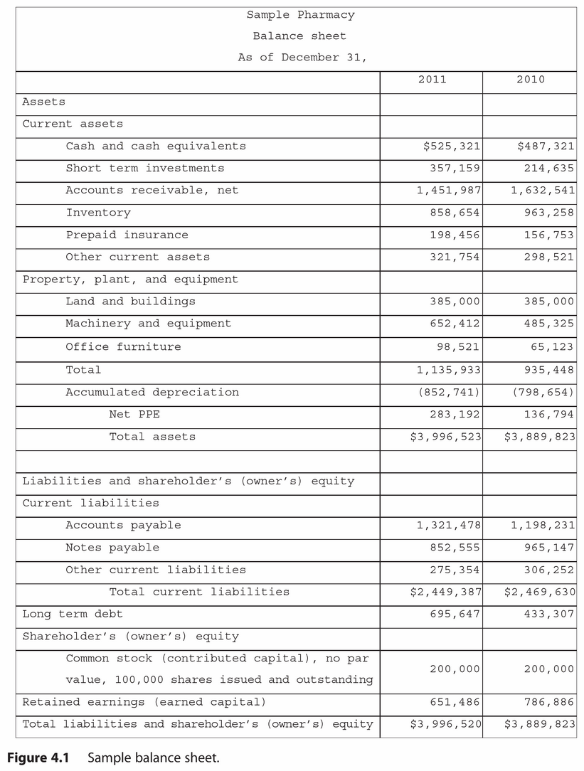
Analyzing a Balance Sheet
While an Income Statement will show the (Revenues – Expenses) over a certain period of time, a Balance Sheet shows the balance since the company started operations
Assets: “Future economic potential for a company”
Liabilities: “Future economic obligations for a company”
Equity = Assets – Liabilities
Herist, Rollins & Perri III. Financial Analysis in Pharmacy Practice.

